Slide 1

ANDHRA TRAVELS
Under the guidance of -
Dr. K Devi Priya
Associate Professor , Dept. of CSE
PRESENTING BY-
G.SAI TEJA
20761A0582
CSE - b

Slide 2

ABSTRACT-
Andhra travels, it’s a type of tour travels web application.
As tourism is one of the fastest growing industries today, all people are willing to travel in the world for a period of time , for that this application is useful for booking travels bus.
In this , we can select our liked district in Andhra Pradesh. They will display all the famous places in each district( up to 6 places).
In this application , Andhra travels is running their tourist buses by specifying some amount of charges per day including Toll charges etc..
They provides a register form for booking travels bus , we can select our journey starting date also.

Slide 3
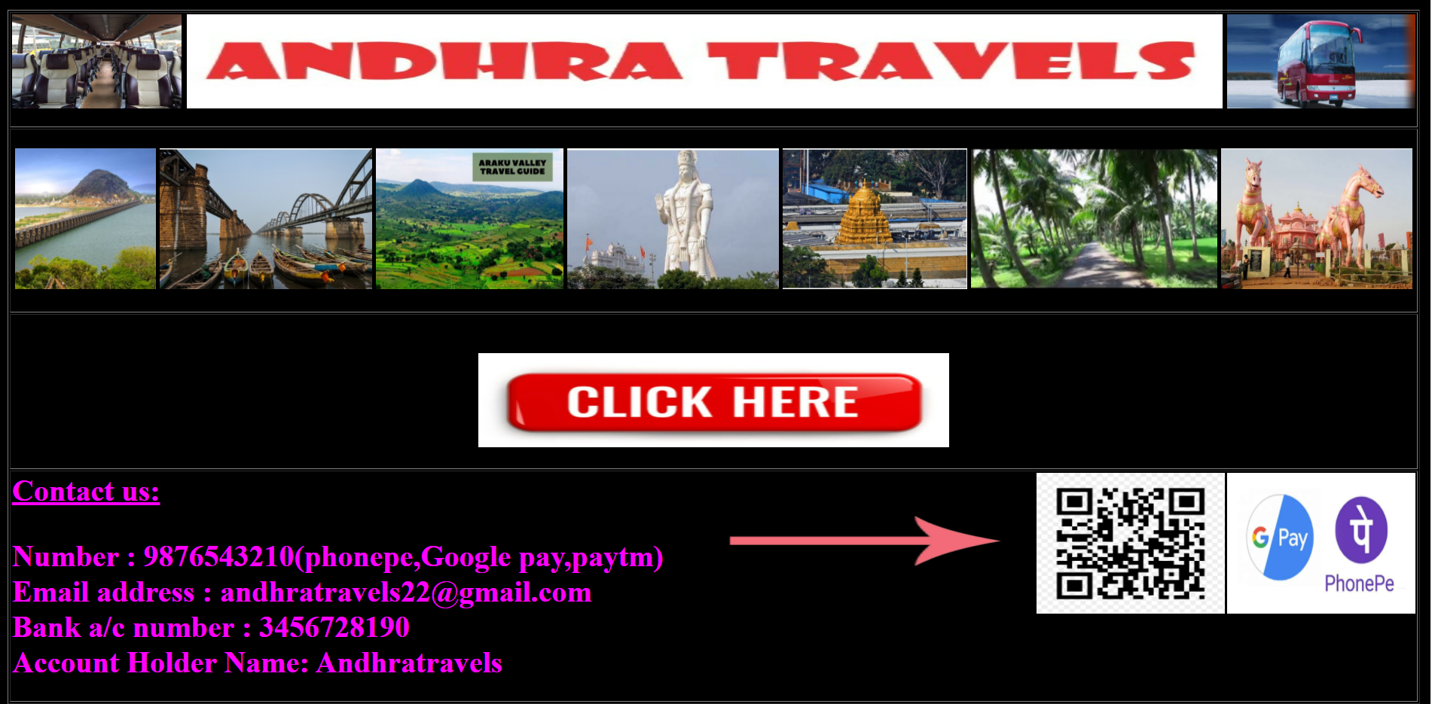
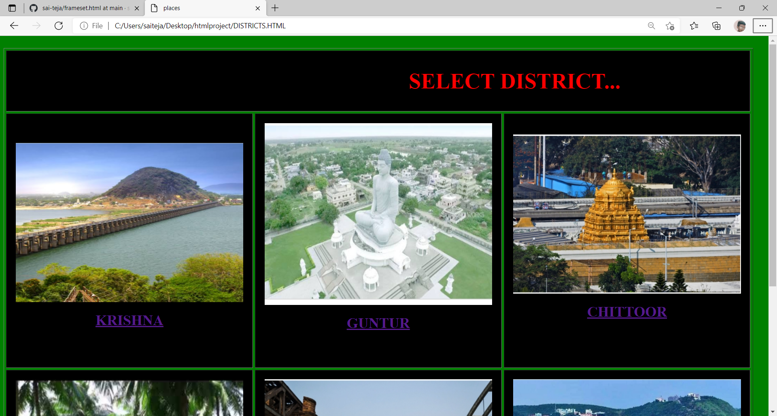
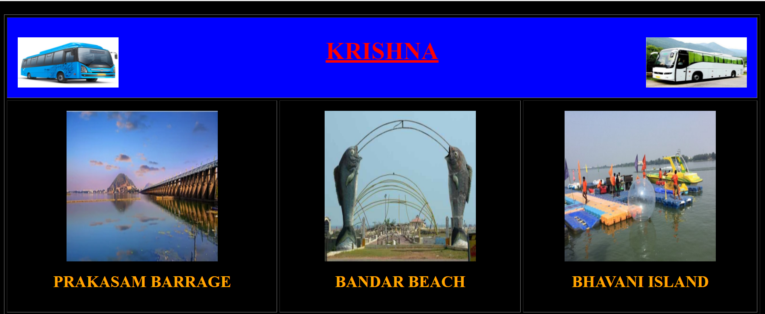
OUTPUT SCREENSHOTS-
HOME PAGE-

Slide 4

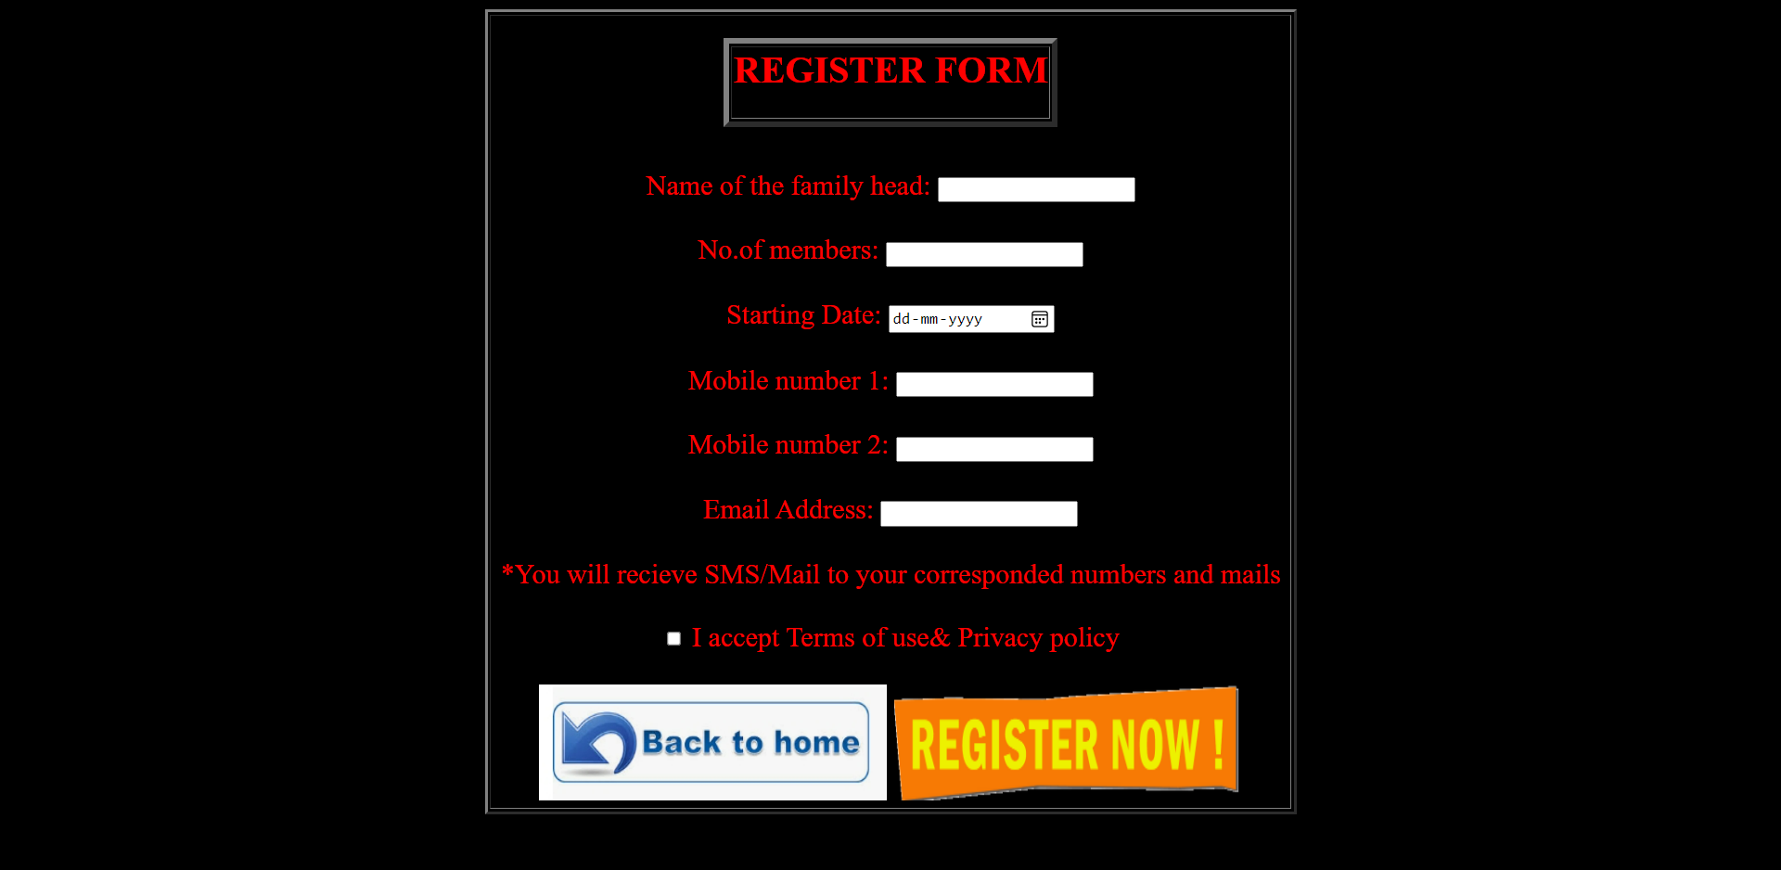
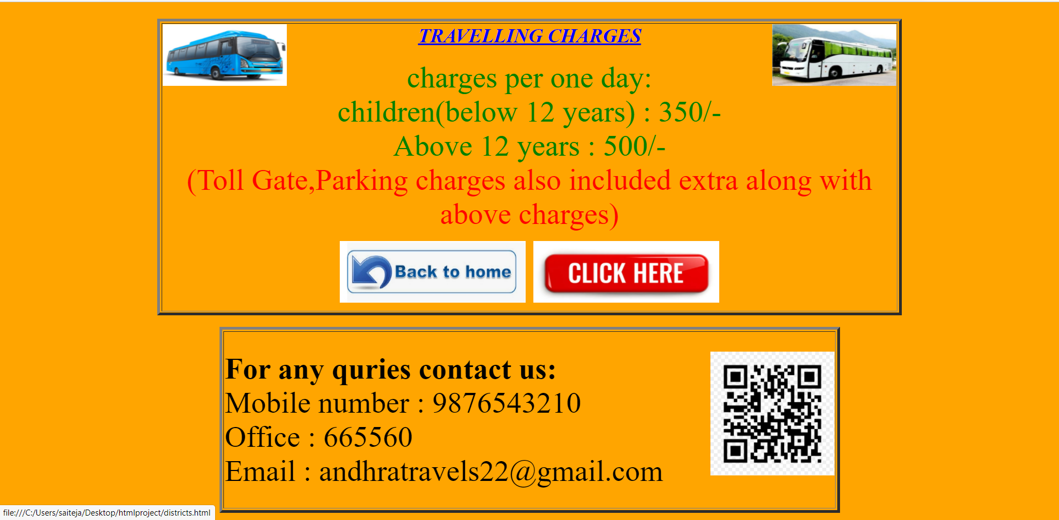

Slide 5
TAGS USED IN MY CODE-
ALL TAGS--
HTML TAGS-
CSS TAGS-
*FONT TAG
*IMG TAG
*HEADING TAGS-<h1><h2><h3>…..
*TABLE-<tr><td>, col span , row span …
*Anchor tag-<a>
*BODY TAG- bgcolor , text…
*INTERNAL CSS- <style> </style>
*background-color ,background-image ,background-repeat….

Slide 6
REFERENCES-
www.w3schools.com
www.tutorialspoint.com
www.tripadvisor.in
https://tourism.ap.gov.in

Slide 7
THANK YOU

